Slide 1
SILVER OAKS COOPERATIVE SCHOOL DATABASE
BY
SUMUKH SHARMA
SHOHINI GHOSH
MADHURA DIGHE
JEFFREY CHEN
POIPATLA NIHAL

Slide 2
BACKGROUND
Silver Oaks Cooperative School (SOCS) is a private, non-profit cooperative school and expected to serve grades K-5 starting from 2020-21.
User group includes Secretary of SOCS board and SOCS management who creates, maintains and updates data of students, members, staff, student healthcare, task details etc.
Data Sources for database design are as follows:
Emergency Form
Accident Release Form
All About Form
Co-Op Preference Form
Media Consent Form
Membership Designation Form
Proxy Form

Slide 3
INTRODUCTION
Mission Statement:
The mission of this project is to enhance the efficiency of the enrollment and administrative process of the school by creating a database to allow entry and tracking of information of key entities. At the end we should be able to generate important documents like membership directory, class rosters, service hour reports, attendance reports.
Mission objectives:
Our goal is to answer following questions using Database.
What are the details of the top 3 Members actively engaged in Co-op tasks at the school?
What are the details students, not having emergency contact details in database?
What are the details of teachers and respective classes they are assigned to?
What are the emergency contact details and medical conditions of the students with less than average attendance?
What are the details of member and corresponding tasks performed at the school?

Slide 4
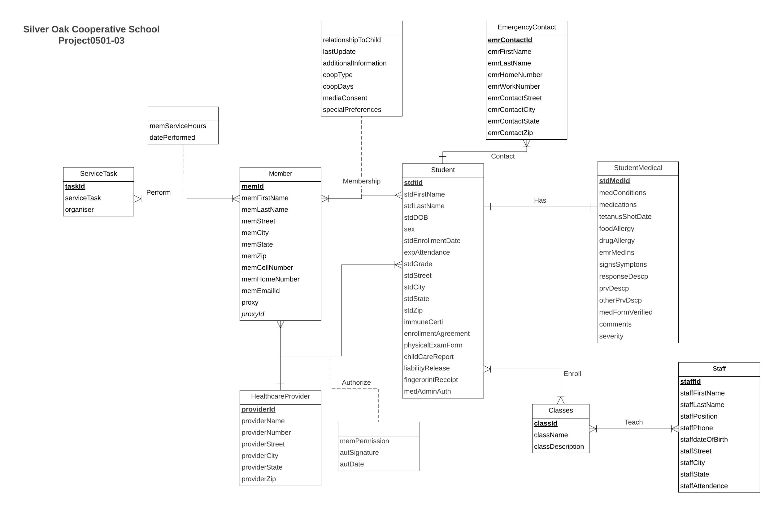
CONCEPTUAL DATABASE DESIGN - ER DIAGRAM

Slide 5
LOGICAL DATABASE DESIGN: RELATIONAL SCHEMA
Member(memId, memFirstName,memLastName, placeOfEmployment, memStreet, memCity, memState, memZip, memCellNumber, memHomeNumber, memEmailId, proxy, proxyId)
Student( stdtId,stdFirstName, stdLastName,stdDOB, sex, stdEnrollmentDate, expAttendance, stdGrade, stdStreet, stdCity, stdState, stdZip,enrollmentAgreement, fingerprintReceipt, physicalExamForm,childCareReport, liabilityRelease, medicalAdministratorAuthorisation, immuneCertificate)
StudentMedical(stdMedId, stdID, medConditions, medications, tetanusShotDate, foodAllergy, drugAllergy, signsSymptons, responseDescp, preventionDescp, comments, medicalFormVerified)
HealthcareProvider(providerId, providerName, providerNumber, providerStreet, providerCity, providerState, providerZip)
EmergencyContact(emrContactId, stdId, emrFirstName, emrLastName, emrHomeNumber, emrWorkNumber, emrContactStreet, emrContactCity, emrContactState, emrContactZip)
ServiceTasks(taskID, serviceTask,memServiceHours, datePerformed, organiser)
Classes(classId , className, classDescription)

Slide 6
CONTINUED..
Staff( staffId , staffFirstName , staffLastName , staffPosition, staffPhone, staffdateOfBirth, staffStreet , staffCity , staffState)
Membership(stdId, memId, relationshipToChild, lastUpdate, additionalInformation, coopType, coopDays, mediaConsent, specialPreferences)
Authorize(stdId, providerId, memId, memPermission, autsignature, autDate)
Enroll (stdId, classId)
Teach(staffId, classId )
Perform(taskId, memId)
Contact(stdId , emrContactId)

Slide 7
PHYSICAL DATABASE DESIGN:
CREATE TABLE [Oaks.Membership] (
stdId INTEGER NOT NULL,
memId INTEGER NOT NULL,
relationshipToChild VARCHAR (15),
lastUpdate DATE ,
additionalInformation VARCHAR (100),
coopType VARCHAR (15),
coopDays VARCHAR(10),
mediaConsent VARCHAR (1),
specialPreferences VARCHAR (1),
CONSTRAINT fk_Membership_stdId FOREIGN KEY (stdId)
REFERENCES [Oaks.Student] (stdId)
ON DELETE CASCADE ON UPDATE CASCADE,
CONSTRAINT fk_Membership_memId FOREIGN KEY (memId)
REFERENCES [Oaks.Member] (memId)
ON DELETE CASCADE ON UPDATE CASCADE );

Slide 8
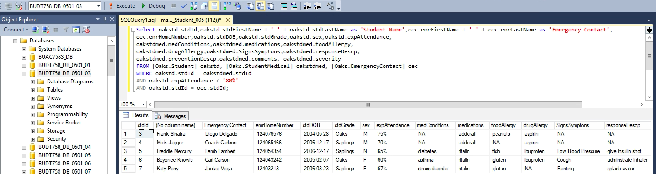
BUSINESS CASES
Case 1 : What are the emergency contact details and medical conditions of the students with less than average attendance?

Slide 9
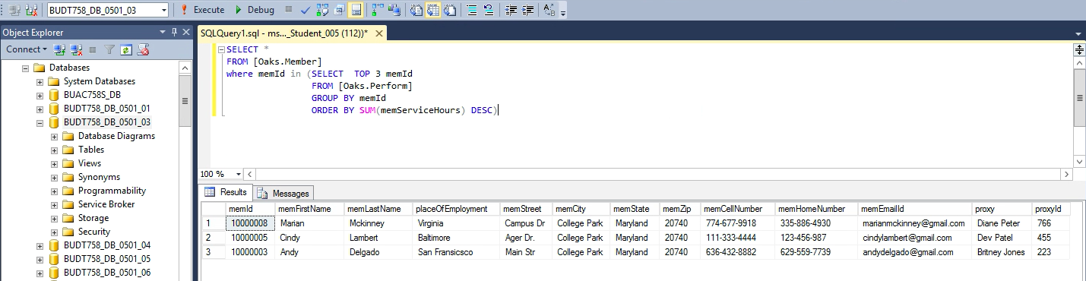
BUSINESS CASES
Case 2: What are the details of the top 3 Members actively engaged in Coop tasks at the school?

Slide 10
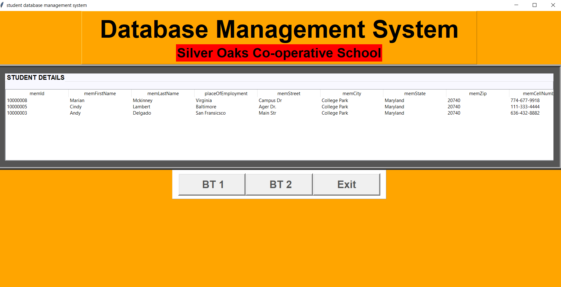
WHO ARE THE TOP 3 MEMBERS WHO ARE ACTIVELY ENGAGED IN COOP TASKS AT THE SCHOOL?
Who are the top 3 Members who are actively engaged in Coop tasks at the school?

Slide 11
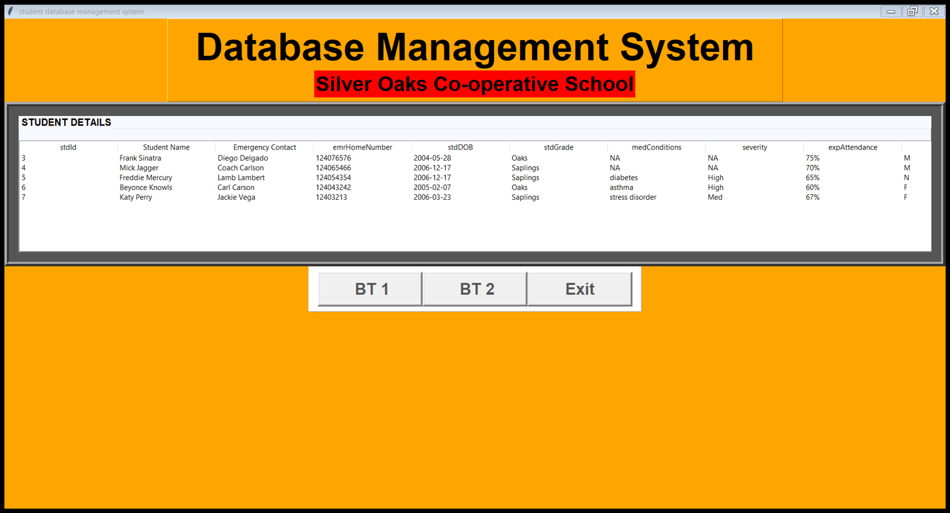
What are the emergency contact details and medical conditions of the students with less than average attendance?

Slide 12
THANK YOU!

